Slide 1
WORLD OF WORK
Anglický jazyk: maturitná téma č. 9
Gymnázium J. G. Tajovského, Banská Bystrica
Mgr. Romana Szentpéteriová
Next

Slide 2
KEY VOCABULARY
Complete the sentences with these words:
career, job, profession, work, occupation
She`s got a good ………….. in a bank.
Tidying my bedroom was hard ……………!
Law, medicine and teaching are respected ....................
He had a successful .................. as a journalist.
Please, fill your .................... in this form
job
work
professions
career
occupation
CHECK

Slide 3
KEY VOCABULARY
Match these groups of expressions with the correct title: (click on the bubbles to check your ideas)
CAREERS
SKILLED WORK
UNSKILLED WORK
medicine art business
information technology design law science
carpenter electrician plumber librarian
labourer street sweeper doorkeeper
delivery man
engineering construction
Engineering is designing and building
roads, bridges and railways.
Construction is designing and building
different types of buildings.

Slide 4
KEY VOCABULARY
Translate these sentences into your mother tongue:
I work nine-to-five.
What do you do for a living?
I`ve been offered a job in Paris.
She does shift-work.
I`ve got a summer job in a garage.
Do you work-part time or full-time?
He`s got the sack and now is unemployed.

Slide 5
MAKING A DECISION
What helps people to choose the ideal job for them?
their personal qualities
their skills and interests
their education possibilities

Slide 6
MAKING A DECISION
Psychological analysis suggests ideal jobs for different types of people. Try to guess them:
a/ for people good at dealing with other people:
b/ for practical people:
c/ for creative people:
d/ for dynamic people:
doctor, nurse, teacher, social worker
accountant, PC programmer, machine designer
journalist, artist, fashion designer, writer
directors, managers, politicians, lawyers
CHECK

Slide 7
LOOKING FOR A JOB
during the study:
a/ follow the job trends
b/ have part-time or summer jobs to get some experience and information about open positions

Slide 8
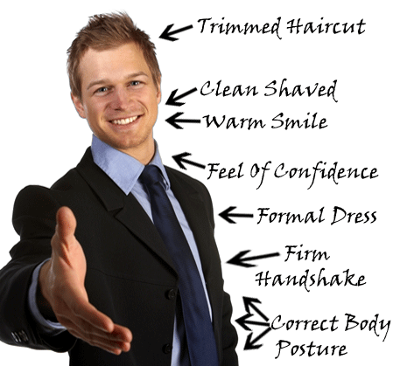
LOOKING FOR A JOB
after the study:
a/ visit an employment agency
b/ ask your relatives and friends
c/ send cover letters and your CV
d/ prepare for .............................
JOB INTERVIEW

Slide 9
JOB INTERVIEW
How to do your best in an interview?
Be punctual
Dress up
Write down your strengths and weaknesses
Make up information about yourself
Make out you understand when you don`t
Go on about your personal life
Don`t criticize present or former colleagues
Come up with a couple questions about the job
Ask about company benefits
Try not to dominate the discussion by speaking too much
CHECK

Slide 10
JOB INTERVIEW
How to be polite?
a/ use the correct expressions, e.g.:
I`m sorry , what do you mean exactly?
Pardon?
Could you repeat that again?
Would you mind repeating that?
b/ use the correct intonation: listen to the sentences and find out which intonation is polite – the falling, flat or one?
rising
CHECK

Slide 11
JOB INTERVIEW
Listen to the interview and answer these questions:
What job is the interview for?
Do you think the interviewee will get the job? Why yes? Why not?

Slide 12
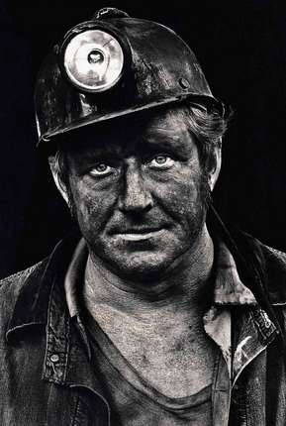
TALKING ABOUT A JOB
Job | Hours of work | Activities at work | Qualities needed | Advantages, disadvantages and possible risks

Slide 13
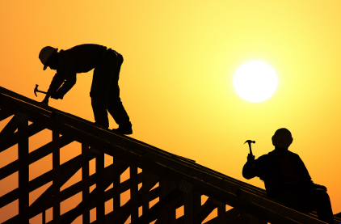
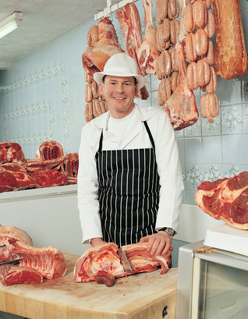
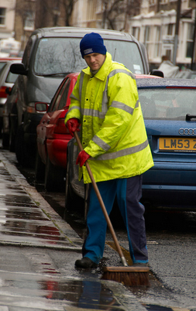
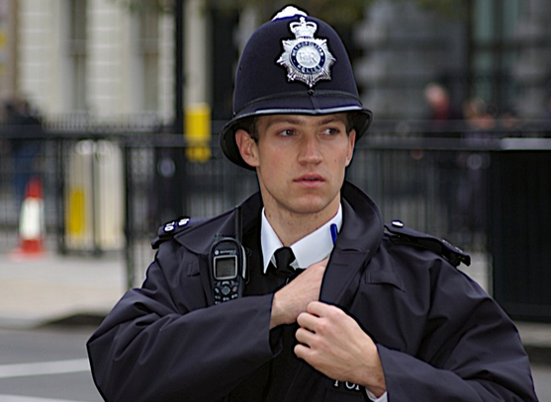
TALKING ABOUT JOBS: Name the jobs in the pictures. (click on the pictures to check your ideas)
Which of them require a university degree?
What are the pros and cons of these jobs?
roofer
microbiologist
music teacher
photographer
butcher
street cleaner
programmer
policeman
Back
Next
End

Slide 14
DANGEROUS JOBS
According to the statistics from November 2013 this is the list of 25 most dangerous jobs in the world. Choose the top five, then watch the video and check your answers.
Deep Sea Fishermen
Street sweepers
Mechanics
Metal crafters
Land Mine Removers
Miners
Bush pilots
Stunt Men
Slaughterhouse Workers
E-Waste Recyclers
Firefighters
Farmers & Ranchers
Astronauts
Lumberjack
Search & Rescue
Personal Transport Drivers
Sanitation Workers
Bodyguards
Police Officers
Courier Carriers
Mountain Guides
Carpenters
Roofers
Alligator Wrestlers & Lion Tamers
Linemen & Power Workers
VIDEO

Slide 15
DANGEROUS JOBS

Slide 16
UNUSUAL JOBS
Guess the job:
Island Caretaker
This exotic job has its own demands though which includes exploring the islands and to discover what the area has to offer. One has to be smart in some fundamental skills including general carpentry, plumbing, gardening skills, communication skills management skills and above all adventurous attitude.

Slide 17
UNUSUAL JOBS
Guess the job:
Hot Walker
Blood heat has to be cooled down after horses finishes up the race to save them from shocks or kidney damage. The person who does this is the Hot Walker.

Slide 18
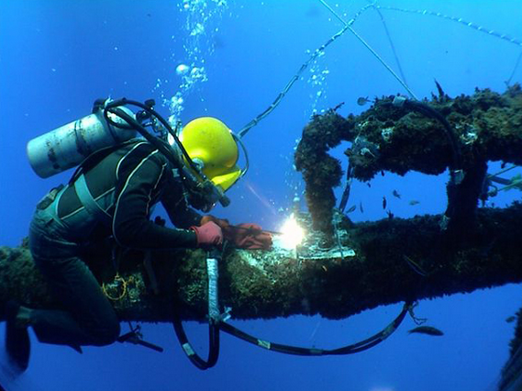
UNUSUAL JOBS
Guess the job:
Oil-Rig Dive Technician
You won’t stay dry while
building rigs and laying pipes on the ocean floor.

Slide 19
FINAL REVISION
A/ Word formation: complete the sentences with correct forms of the word EMPLOY
It is the duty of the ................... to ensure that female workers are not discriminate.
............................ is a serious problem in some countries in Europe.
We can see from this chart that the rate of ........................ fell in the third quarter.
Some companies do not reward their ...................... as well as others do.
This company prefers to .................... people with experience rather than better qualified graduates.
B/ Cloze test: complete the sentences with the correct expressions
In many countries the age of .................. is now 68 or even 70.
One side-effect of adopting these new technologies is that it has led to mass ..................... in the manufacturing industry.
In some professions, such as law, the ........................ are much longer than in others.
Why should I quit my job? I`m on a …………….. and I get on with other members of ………….. , too.
His …………………. to office manager has been his biggest career move.
Joe was ……………….................. because he messed up an important order, which cost his company a lot of money.
employer
Unemployment
employment
employees
employ
retirement
redundancies
working hours
good salary
staff
promotion
fired/ sacked/ dismissed
CHECK

Slide 20
HOMEWORK
Describe your parents` jobs and your future job: name of the job, working hours,
activities at work, qualities and skills needed, advantages, disadvantages and possible risks
2. Find more unusual jobs
3. Explain these quotes:
„The person who is waiting for something to turn up
might start with their shirt sleeves“ G. Henricks
„God gives every bird its food, but he does
not throw it into its nests.“ J.G.Holland

