Slide 1
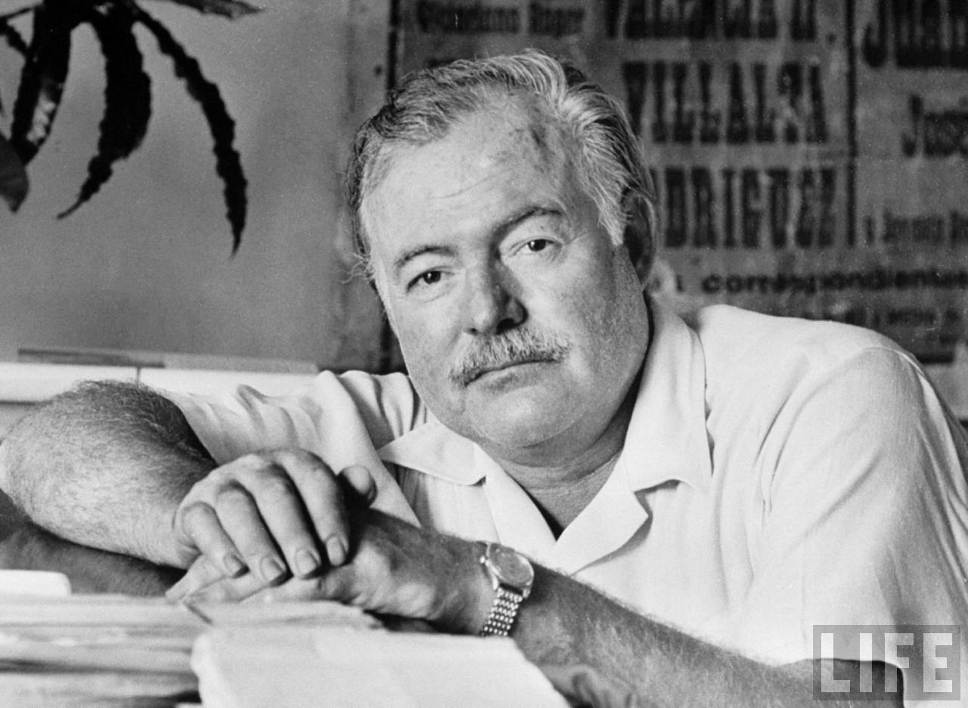
Ernest Hemingway
Mgr. Vlasta Moncoľová
Gymnázium J.G.Tajovského
Banská Bystrica
2014
next
back
end

Slide 2
Early Life and Career
Ernest Miller Hemingway was born on July 21, 1899, in Cicero (now in Oak Park), Illinois. Clarence and Grace Hemingway raised their son in this conservative suburb of Chicago, but the family also spent a great deal of time in northern Michigan, where they had a cabin. It was there that the future sportsman learned to hunt, fish and appreciate the outdoors.

Slide 3
The Life of Ernest Hemingway
Born on July 21, 1899, in Cicero (now in Oak Park), Illinois, Ernest Hemingway served in World War I and worked in journalism before publishing his story collection In Our Time. He was renowned for novels like The Sun Also Rises, A Farewell Hemingway to Arms, For Whom the Bell Tolls, The Life of Ernest and The Old Man and the Sea, which won the 1953 Pulitzer. In 1954, Hemingway won the Nobel Prize. He committed suicide on July 2, 1961, in Ketchum, Idaho.

Slide 4
In high school, Hemingway worked on his school newspaper,Trapeze and Tabula, writing primarily about sports. Immediately after graduation, the budding journalist went to work for the Kansas City Star, gaining experience that would later influence his distinctively stripped-down prose style.
He once said, "On the Star you were forced to learn to write a simple declarative sentence. This is useful to anyone. Newspaper work will not harm a young writer and could help him if he gets out of it in time."

Slide 5
Military Experience
In 1918, Hemingway went overseas to serve in World War I as an ambulance driver in the Italian Army. For his service, he was awarded the Italian Silver Medal of Bravery, but soon sustained injuries that landed him in a hospital in Milan.
There he met a nurse named Agnes von Kurowsky, who soon accepted his proposal of marriage, but later left him for another man. This devastated the young writer but provided fodder for his works "A Very Short Story" and, more famously, A Farewell to Arms.

Slide 6
Military Experience
Still nursing his injury and recovering from the brutalities of war at the young age of 20, he returned to the United States and spent time in northern Michigan before taking a job at the Toronto Star.
It was in Chicago that Hemingway met Hadley Richardson, the woman who would become his first wife. The couple married and quickly moved to Paris, where Hemingway worked as a foreign correspondent for the Star.

Slide 8
Life in Europe
In 1925, the couple, joining a group of British and American expatriates, took a trip to the festival that would later provided the basis of Hemingway's first novel, The Sun Also Rises. The novel is widely considered Hemingway's greatest work, artfully examining the postwar disillusionment of his generation.

Slide 10
QUIZ
What meal was Santiago together with a boy going to have?
Did Santiago let the boy join him?
When Santiago was in the age of a boy what did he do?
What was Santiago going to put into a huge fish?
With whom did Santiago play a hand grip game?
Why did they change the referees every four hours?
The match started on Sunday morning and ended on...?
Santiago said the fish is my......but I must kill it.
How old was the boy, when Santiago first took him in a boat?
Who ate Santiago s big fish?
1.supper
2.) he had to stay
3.) was on a ship to Africa
4.) harphoon
5.) the strongest man in a dock
6.) so that they could sleep
7.) on Monday morning
8.) brother
9.) 5 years old
ANSWERS
10.) the sharks

Slide 11
Fill in the gaps with the correct form of the vérbs in the box: write bring go can see to be
1. Ernest Hemingway........................ a story „The Old Man and the Sea.“
2. „Santiago ! I................................go with you again!“
3. „You told me you ..........................lions.“
4. „ I remember everything from when we first...................together.“
5. Santiago ........................a big fish.
6. The boy wished, he....................with the old man.
7.The boy ....................something to eat for Santiago.
wrote
will go
had seen
were
brought
was
brought

Slide 12
In which state was Hemingway born?
New York
Illinois
Minesota
Florida
Which newspaper did Hemingway report after high school?
The New York Times
The USA Today
The Kansas city Star
The State Journal
In 1918 Hemingway signed up to be an ambulance driver in what country?
America
France
Italy
Ireland
Hemingway was married four times.
True
False

Slide 13
In what year did Hemingway receive the nobel prize in Literature?
1924
1960
1954
1950
Hemingway uses his war experiences to write which novel?
The Old Man and the Sa
Farewell to Arms
For Whom the Bell Tolls
Death in the Afternoon
How did E. Hemingway die in 1961?
Heart attack
Car accident
Suicide
Drug Overdose

Slide 14
Which of the following statements is true about Hemingway?
He died of a heart attack in 1961
He was almost killed in a plane crash in 1954
He was born in Ketchum, Idaho
He was married twice
Which one of Hemingway's books described the post-World War I generation?
A Farewell to Arms
A Moveable Feast
The Sun Also Rises
For Whom the Bell Tolls
Which book was the Hemingway's last major work published in 1951?
The Old Man and the Sea
A Farewell to Arms
The Sun Also Rises
For Whom the Bell Tolls

Slide 15
Thank you for your attention

